Slide 1
MVC in iPhone Development,
View & Drawing
TMA Training Center (TTC)
Course | iPhone application development
Trainer | Thuong Tran
Designed by | TMA Mobile Solutions (TMS)
Last updated | 28 Feb 2011

Slide 2
This section objectives
Understanding about MVC in iPhone Development

Slide 3
Content
MVC in iPhone Development
Nib Files
Interface Builder Demo
Target - Action and Demo
View Controllers and Interface Rotation Demo

Slide 4
Content
View
  UIWindow
  View Coordinate System & Operations
  View View Ownership & Core Graphics
  Create/Remove View/Customview
Drawing
  CoreGraphics and Quartz 2D
  Graphic Context & Wrapper
  Draw Rect
  Draw Complex Shape
Project assignment: design and implementation

Slide 5
MVC in iPhone Development

Slide 6
Why MVC ?
Absolutely critical to understand in iPhone development world
Xcode sets it up automatically with MVC in new projects
Used throughout the general software development industry to build robust, reusable and extensible code
  Important to separate the view from business logic and model
  Important to separate model from the business logic and view
  Facilitates unit testing

Slide 7
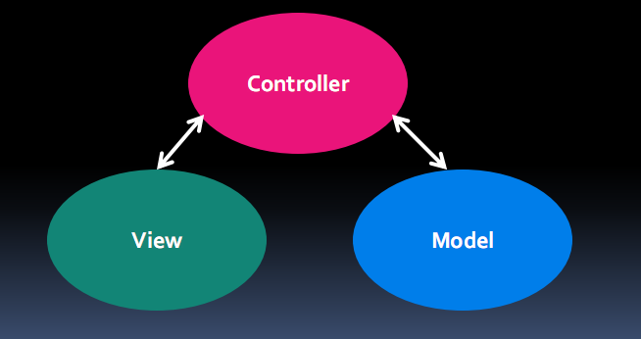
MVC in iPhone development
Below is the general picture for MVC

Slide 8
Model
Manages and represents the only application state and data
  Does not concerned itself with the presentation of data
The data is often persisted somewhere: SQL Lite, a file,..

Slide 9
View
This is responsible for the presentation of the model in the fitting user interface
Gives an interface to allow the user to manipulate the data
  Ie. Entering text in a text field and then saving via save button
Since it is separate from the model it should be modular and adaptable to different data
There is no data storage in the view except to cache internal state

Slide 10
Controller
Acts as the intermediary between the model and the view
When the view is changed by the user
  ie. A switch to turn on music, the controller updates the model
When the model changes the view controller updates the view
This is where the business logic resides in the application
  The function purpose of the application

Slide 11
UIViewController
Subclass to add your application logic
You may have many view controllers to keep your application design clean and manageable
  For example, for each screen have a different view controller
You should have one *.nib file per ViewController

Slide 12
“View” of UIViewController
The reason why the controller is called ‘ViewController’ is because the UIViewController superclass has a view property
  @property (retain) UIView *view
You would assign the view to this property using self.view=…
This allows the view to be removed if memory is getting low (you can hook into those events)

Slide 13
View and ViewController
To create your connection between a view and the view controller:
  Name File’s Owner to view controller class
  Ctrl click from Files Owner to view outlet
  Implement –initWithNibName:bundle:

Slide 14
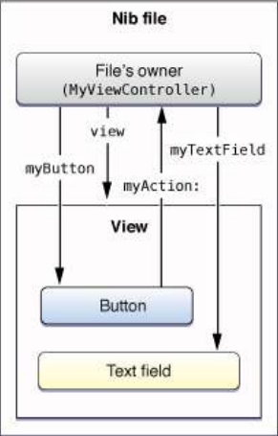
Nib File
• Configured Outlets/Actions for your ViewController
• These connects are restored when iPhone application launches

Slide 15
Interface Builder Demo

Slide 16
Exercise
Create a Calculator in Interface builder
  Have a label to show number and result
  Have numbers from 0-9
  Have signs : +,-,*, / , =

Slide 17
Target-Action

Slide 18
Target-Action
It is a fundamental paradigm in Cocoa Touch
Used mostly in user interface that allow the user to initiate an action
  ie. A user clicks a button (an event) and an action is initiated
Controls can respond to a variety of events
Touch Events (ie. For a game piece view)
  • touchDown
  • touchUp (inside, outside)
  • touchDragged (entered, exited, drag inside, drag outside)

Slide 19
Target-Action
Editing Events (ie. For TextFields)
  • editing began
  • editing changed
  • editing ended
Value changed

Slide 20
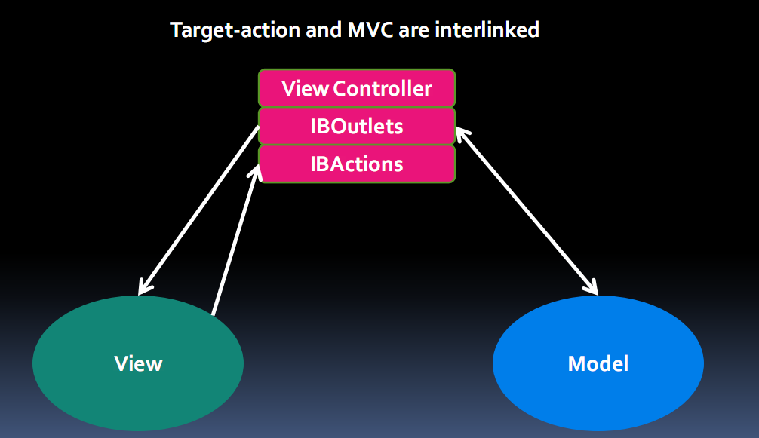
Target-Action and MVC

Slide 21
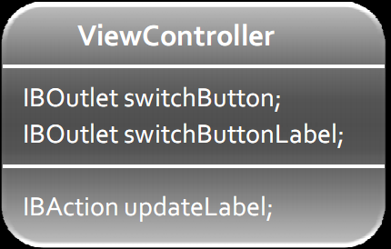
Target-Action and MVC
IBOutlet is similar in concept to a reference but in this case it points to a view control
IBAction is the action the control would call once an event has fired

Slide 22
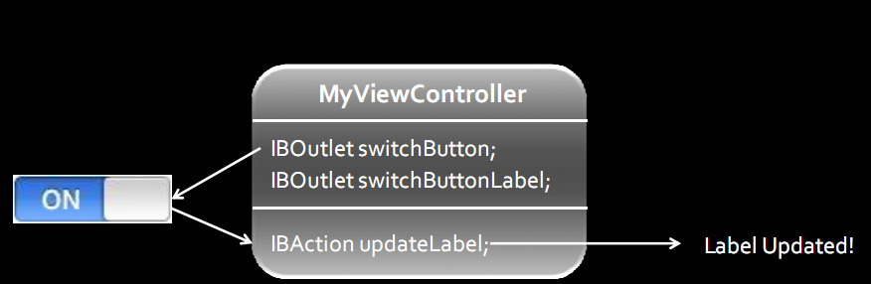
Target-Action and MVC
Target: MyViewController Object
Action: updateLabel:
Event: UIControlEventTouchUpInside

Slide 23
Target-Action Demo

Slide 24
Exercise
Create IBOutlets and IBActions for last Calculator
Implement function show number when click each button
Edit IBActions
Implement all function of a calculator.

Slide 25
Interface Rotation

Slide 26
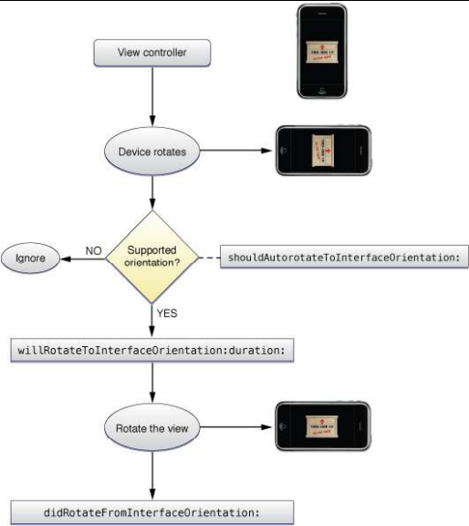
Interface Rotation

Slide 27
Interface Rotation
-(BOOL)shouldAutorotateToInterfaceOrientation: (UIInterfaceOrientation)interfaceOrientation {
// view controller returns only Portrait
return (interfaceOrientation == UIInterfaceOrientationPortrait);
}
(BOOL)shouldAutorotateToInterfaceOrientation:(UIInterfaceOrientation)interfaceOrientation{
// All orientations except UpsideDown are supported
return (interfaceOrientation != UIInterfaceOrientationPortraitUpsideDown);
}

Slide 28
Interface Rotation event
(void)willRotateFromInterfaceOrientation: (UIInterfaceOrientation) fromInterfaceOrientaion {
// Do something
}
(void)didRotateFromInterfaceOrientation: (UIInterfaceOrientation) fromInterfaceOrientaion {
// Do something
}

Slide 29
Exercise
Pop up to inform user about their rotation screen
  e.g: show pop up: “you rotated your screen to the left” when user rotate their phone to the left

Slide 30
Interface Rotation Demo

Slide 31
View

Slide 32
Views Introduction
Views are rectangular objects on the screen
Can have multiple views on top of each other (clipping/transparency/visibility)
Inside the view you can draw your content
It handles events since view subclasses from UIResponder which is an event handling class
Each view has a superview and could have subviews (hierarchical structure)

Slide 33
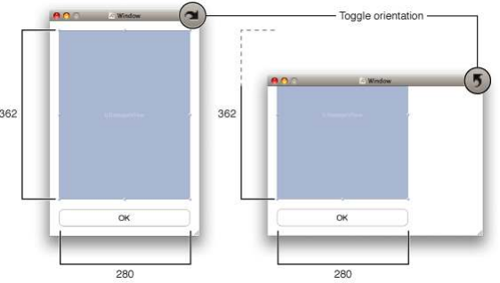
UIWindow
Each iPhone app has one window
  All views live inside this window
  A window is also a view but contains more functionality as it is the top level view

Slide 34
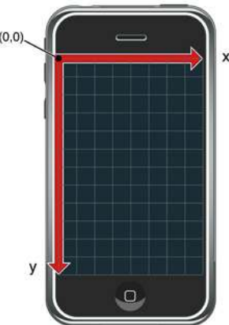
View Coordinate System

Slide 35
View Operations
Add/remove views in IB or using UIView methods
  -(void)addSubview:(UIView *)view;
  (void)removeFromSuperview;
Manipulate the view hierarchy manually:
  -(void)insertSubview:(UIView *)view atIndex:(int)index;
  -(void)insertSubview:(UIView *)view belowSubview:(UIView *)view;
  -(void)insertSubview:(UIView *)view aboveSubview:(UIView *)view;
  -(void)exchangeSubviewAtIndex:(int)index withSubviewAtIndex:(int)otherIndex;

Slide 36
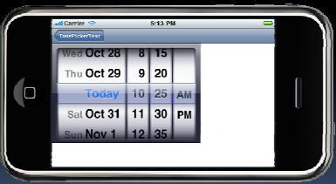
View Ownership
Superviews retain their subviews thus important to be careful when removing
  retain subview before removing superviews if you want to reuse it
  otherwise, superview will go away as well as the subview and if you try to access the subview you will get a crash
  If don’t want a subview temporarily you can hide it by calling
    subView.hidden = YES;

Slide 37
Exercise
Create a view-based application project
Add 3 new views, each view have a number (1-3).
Use add/remove/insertSubview function and report to class about your results

Slide 38
View Core Graphics
CGPoint
  location in space: { x , y }
CGSize
  dimensions: { width , height }
CGRect
  location and dimension: { origin , size } • location and dimension: { origin , size }

Slide 39
Creating Views
•Two ways: via interface builder and manually in code:
  In interface builder, drag and drop the items you want in your window
  Programmatically, you would need to allocate a frame and then allocate a view and initialized by passing in the aforementioned frame and initialized by passing in the aforementioned frame
CGRect frame = CGRectMake(20, 45, 140, 21);
UILabel *label = [[UILabel alloc] initWithFrame:frame];
[window addSubview:label];
[label setText:@”Number of sides:”];
[label release]; // label now retained by window

Slide 40
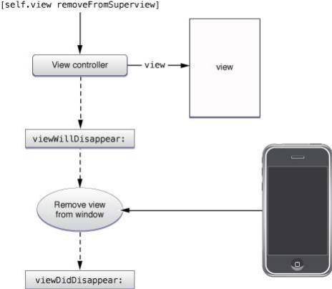
Removing views

Slide 41
Custom Views
To write a custom view, you need to subclass UIView
You will need to override -(void)drawRect:(CGRect)rect;
  Note drawRect does not do anything by default
  drawRect is called automatically
  Being lazy is good for performance
  Use –(void)setNeedsDisplay when view needs to be redrawn
For example, in your controller update the view and then call -setNeedsDisplay:
-(void)setNumberOfSides:(int)sides {
numberOfSides = sides;
[polygonView setNeedsDisplay]; }

Slide 42
Exercise
Create a view-based project:
  Have 2 button: Personal information & My team
  Create 2 custom view (smaller than current view) to show your personal information and your team.
  Click each button at the first time: show your custom view
  Then, click each button at the second time: hide your custom view.

Slide 43
Drawing

Slide 44
CoreGraphics and Quartz 2D
UIKit itselfoffers very basic drawing functionality
UIRectFill(CGRect rect);
UIRectFrame(CGRect rect);
iPhone Programming 101 46
Quartz is the main technology for drawing on the iPhone
  CoreGraphics: Drawing APIs which is at the heart of Quartz
  CG is a C-based API, not Objective-c
UIKit providers Quartz Objective C wrappers for UIKit classes

Slide 45
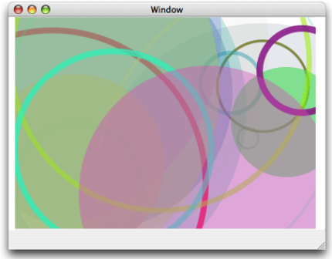
CoreGraphics and Quartz 2D
CG and Quartz 2D drawing engine define elegantly powerful graphics operations:
Graphics contexts
Paths (see picture)
Images and bitmaps
Transparency layers
Colors, patterns… Gradients/shadings
Fonts
PDF content

Slide 46
Graphics Context
All drawing is done into a graphics context
  Draws to a bitmap buffer, the screen, a PDF file…
  Before calling drawRect: the view object automatically creates the context
The graphics context defines several basic attributes such as color, paths, line width…
You can access the graphics context inside the drawRect: by calling (CGContextRef)UIGraphicsGetCurrentContext(void);
You can use CG calls to change the context
Since the context is only valid for the current call to drawRect: don’t save it

Slide 47
CoreGraphics Wrappers
Some CG functionality wrapped by UIKit (Objective C)
  UIColor
  This is a convenience object for common colors
  Facilitates stroke and fill colors when drawing
  // Now drawing will be in blue
  UIColor *blueColor = [UIColor blueColor];
  [blueColor set];
  • UIFont
  Can access system fonts or custom fonts
  To set a particular font:
  UIFont *myFont = [UIFont systemFontOfSize:8.0];
  [viewLabel setFont:myFont];

Slide 48
drawRect: Example
Draw a solid color and shape
-(void)drawRect:(CGRect)rect {
CGRect bounds = [self bounds];
[[UIColor grayColor] set];
UIRectFill (bounds);
//Create a CGRect square
CGRect square = CGRectMake (8, 8, 60, 120);
[[UIColor blueColor] set];
UIRectFill (square);
[[UIColor blackColor] set];
UIRectFrame (square); }

Slide 49
Drawing More Complex Shapes
Here are the common steps for drawRect:
  Get the current graphics context
  Define the path of the graphic
  Define a color
  Define stroke/fill path
  Repeat a nescessary

Slide 50
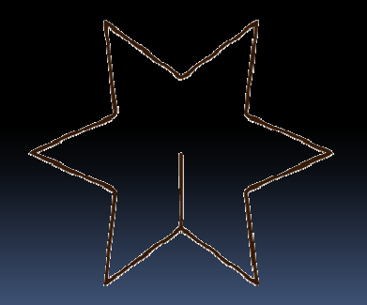
CG Paths
CG paths make up shapes
The paths are made up of lines, rectangles, curves and arcs
Note creating and drawing are different things
After you define the path, you need to expliciltly call the draw method!

Slide 51
CG Path Example
-(void)drawRect:(CGRect)rect {
CGContextRef context = UIGraphicsGetCurrentContext();
[[UIColor grayColor] set];
UIRectFill ([self bounds]);
CGContextBeginPath (context);
CGContextMoveToPoint (context, 50, 5);
CGContextAddLineToPoint (context, 15, 120);
CGContextAddlineToPoint(context, 15, 120);
CGContextAddLineToPoint (context, 155, 120);
CGContextClosePath (context);
[[UIColor blueColor] setFill];
[[UIColor blackColor] setStroke];
//Need to call draw!
CGContextDrawPath (context, kCGPathFillStroke);
}

Slide 52
Drawing Demo

Slide 53
Exercise
Create a project and draw a car in the screen.

